Slide 1
Crop Disease Prediction
Plantify-Ai
MINOR PROJECT-II (AD-608)

Slide 2
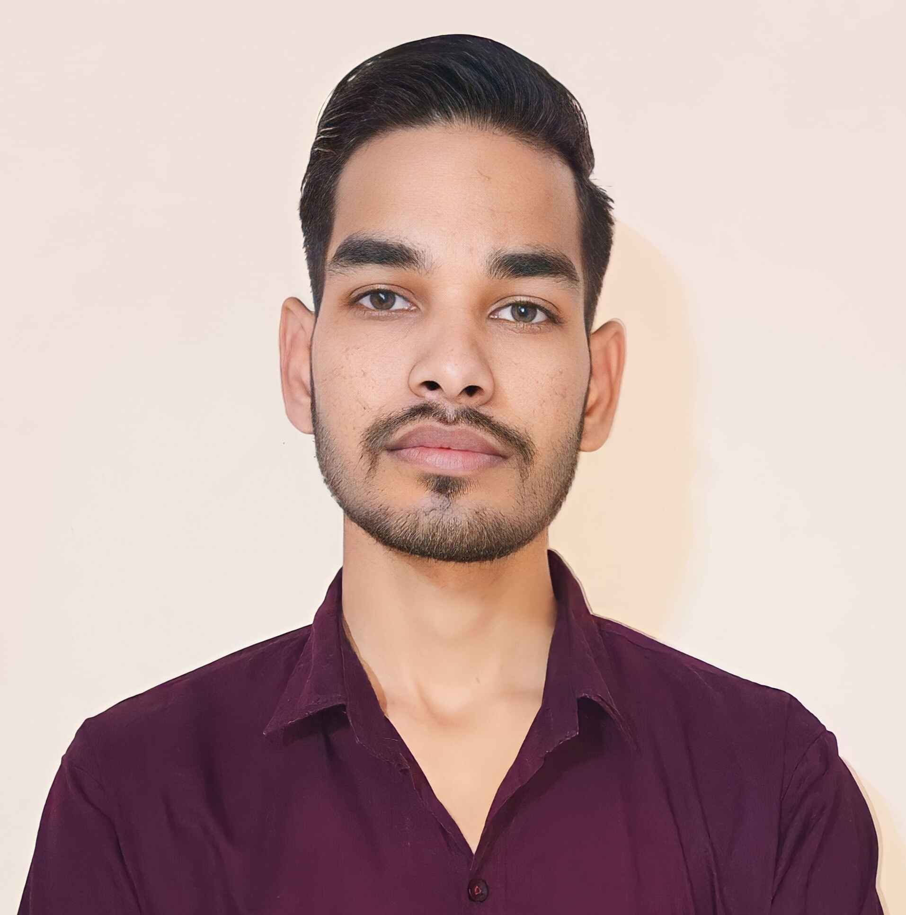
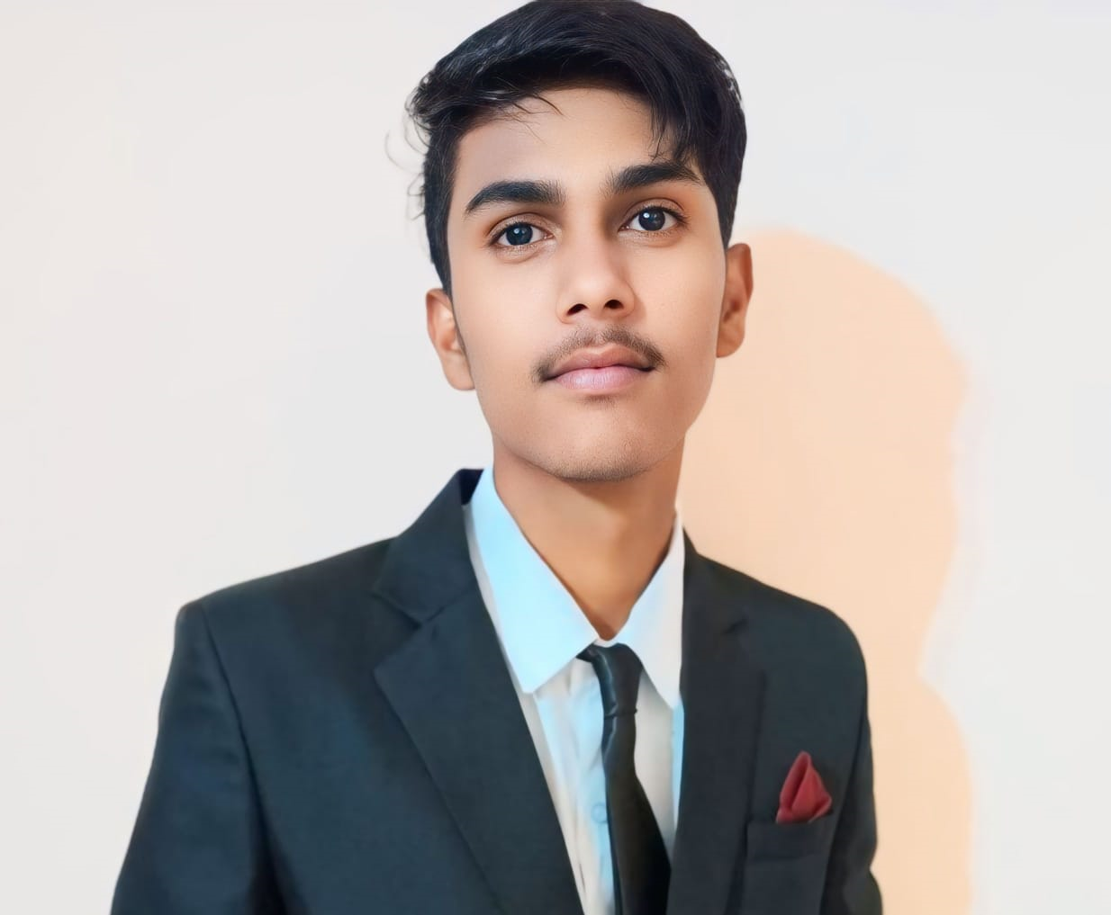
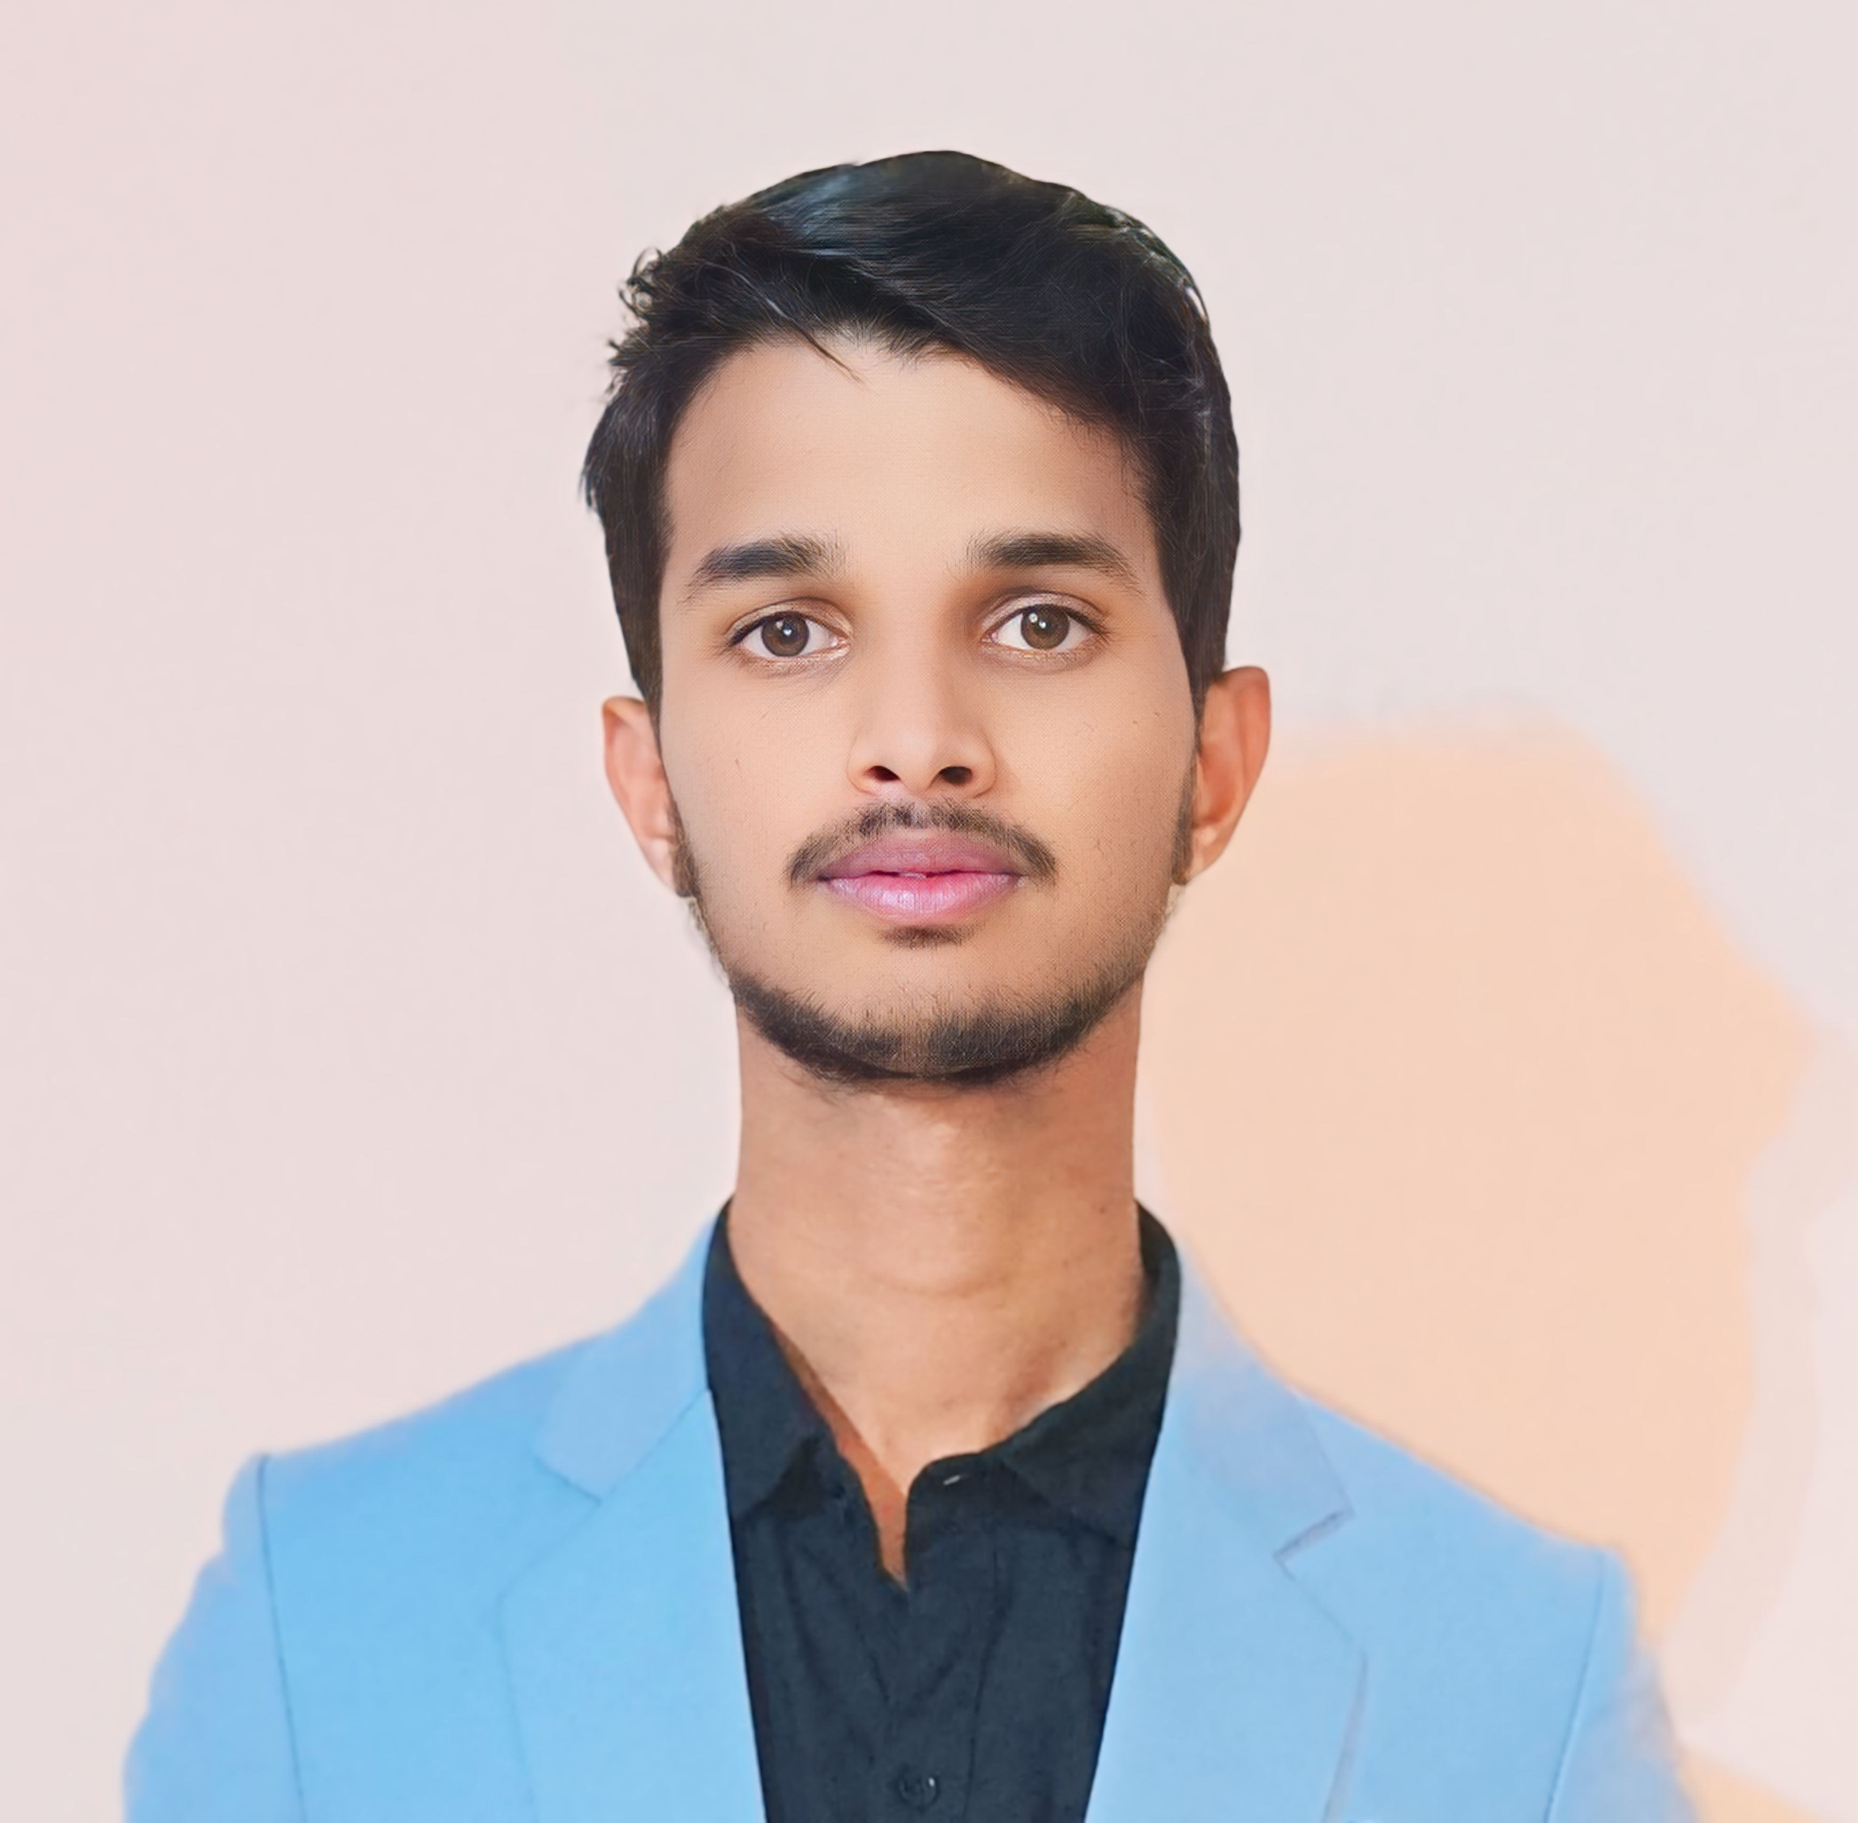
OUR TEAM MEMBERS
Monu Kushwah
Aman Sahu
Shyam Sahu
OUR GUIDE
Dr. Vasima Khan

Slide 3
IDEA/APPROUCH/DETAIL
This project aims to build a system that helps farmers identify crop diseases by using deep learning. Pretrained convolution neural network (CNN) like VGG16 to analyze images of plant leaves and detect diseases automatically.
We train a CNN model using leaf images of healthy and diseased plants. The system then uses this trained model to predict the disease from new leaf images. This helps farmers take quick action and apply the right treatment at the right time.

Slide 4
ABSTRACTION
A crop disease prediction system leverages data-driven deep learning techniques to assist farmers in early detection and classification of plant diseases, aiming to minimize yield loss and ensure healthier crop production. By analyzing visual symptoms in leaf images through Convolutional Neural Networks (CNNs), the system identifies specific diseases with high accuracy. These models are trained on diverse datasets to recognize disease patterns across different crop types. The system can be enhanced by incorporating continuous feedback from users and updated image data, enabling it to improve over time and support informed decision-making, effective disease management, and sustainable farming practices.

Slide 5








TECHNOLOGY

Slide 6
REQUIREMENT
Functional
Non-Functional
User Registration and Authentication
User Profile updation
Image Upload for Disease Detection
Disease Prediction.
Performance
Usability
Responsiveness
Scalability

Slide 7
REQUIREMENT
HARDWARE
SOFTWARE
Processor :-
Intel i3 and above
Operating system :-
Windows, Mac, Linux
RAM :-
4GB : Minimum
Coding Language :-
Python, Deep Learning
Hard Disk :-
256GB: Minimum
Tools & libraries :-
Vs Code, Numpy, Pandas, CNN
Tensorflow, Matplotlib, Keras.

Slide 8
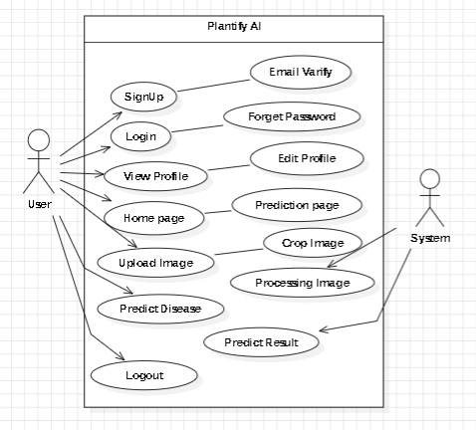
Use Case Diagram

Slide 9
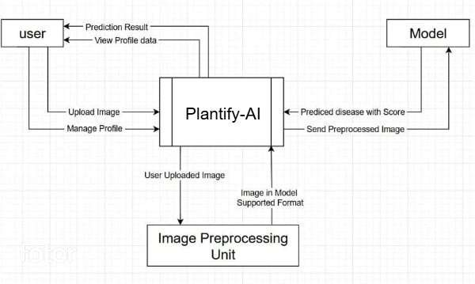
Data Flow Diagram

Slide 10
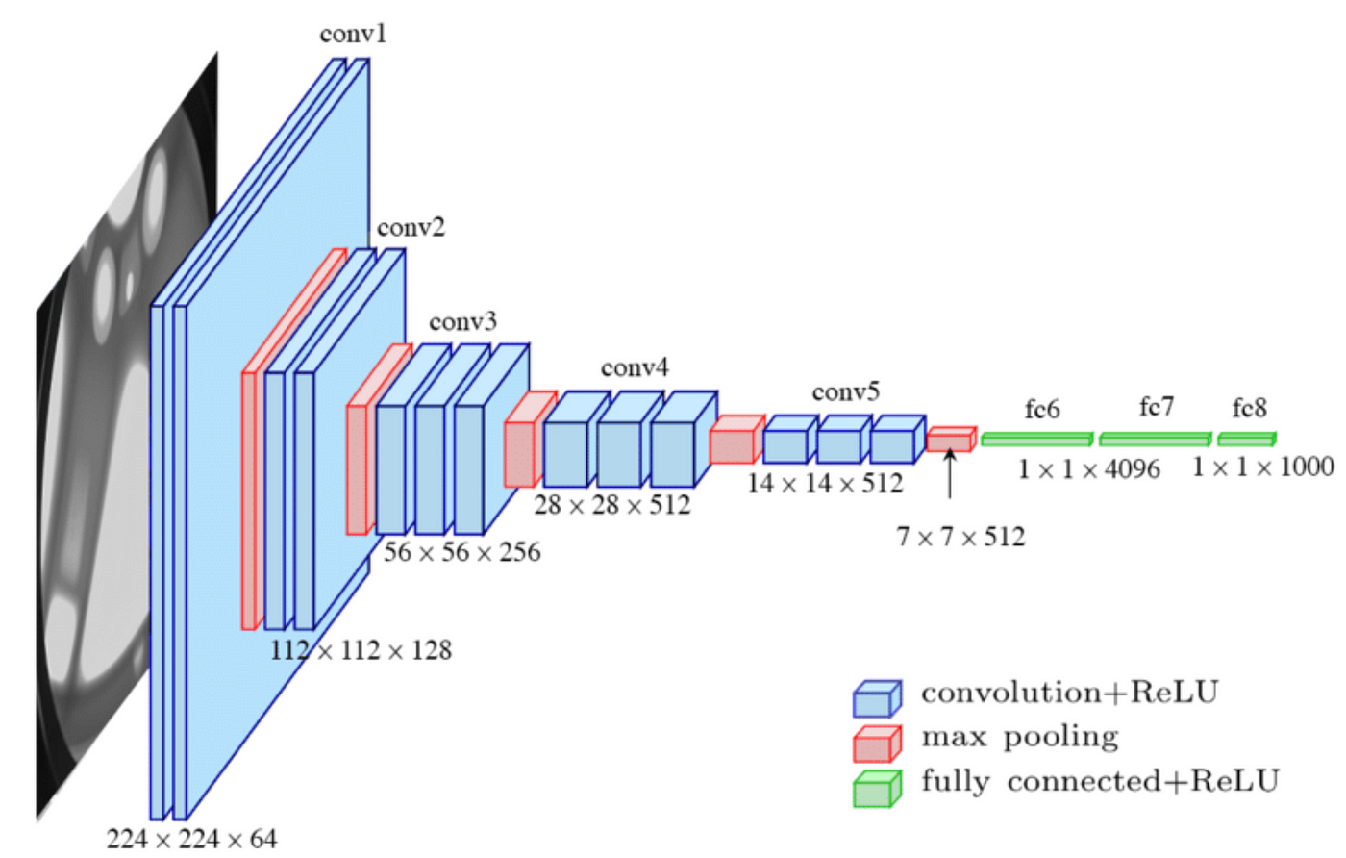
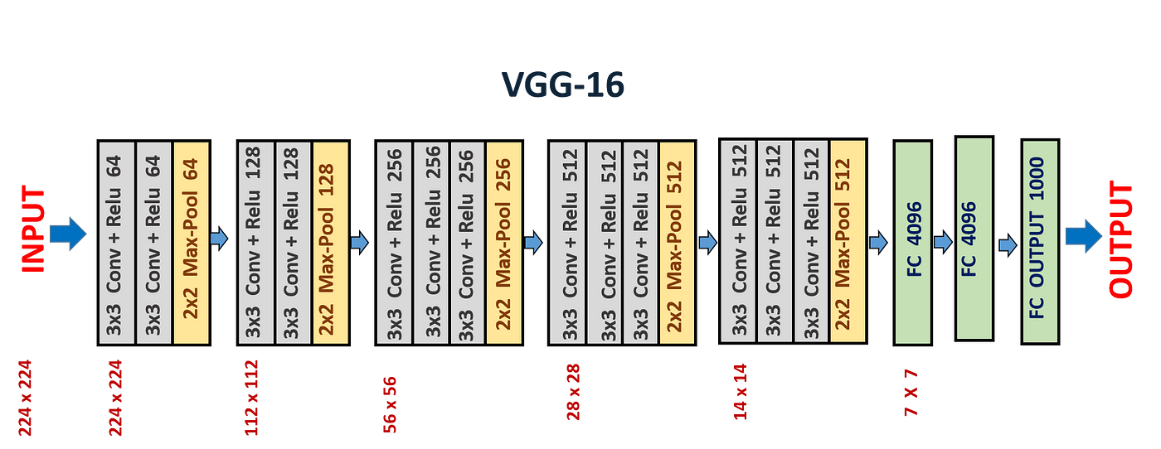
VGG16 ARCHITECTURES

Slide 11
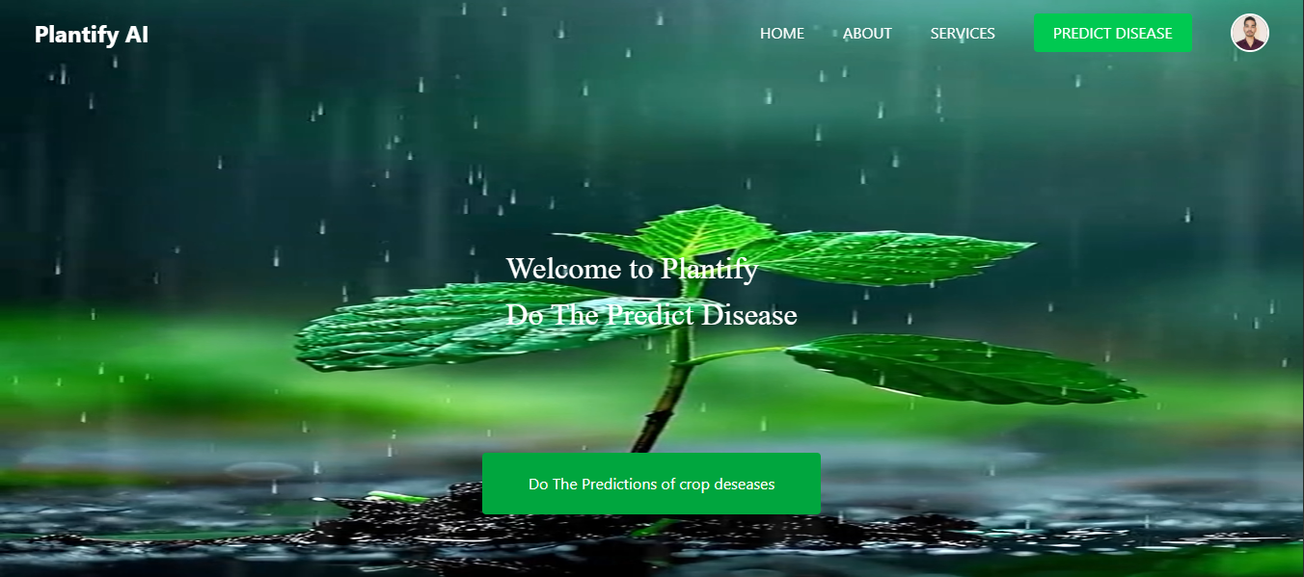
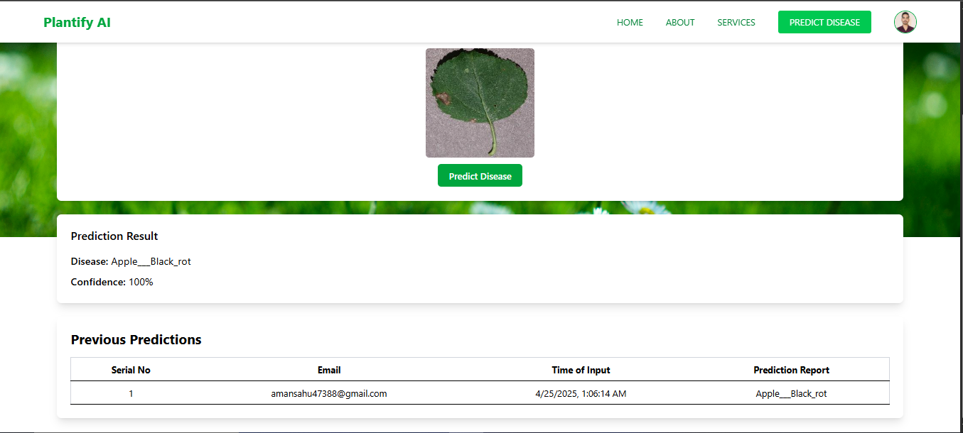
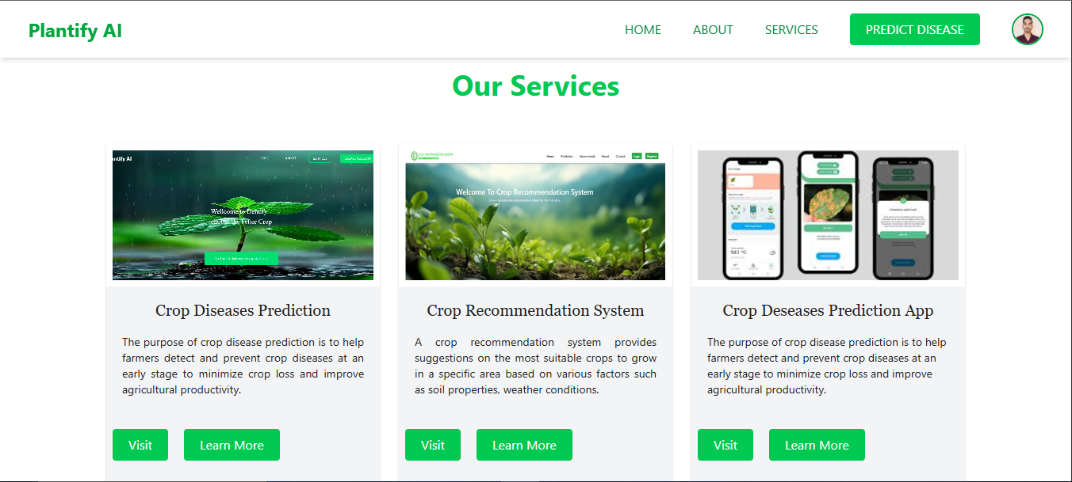
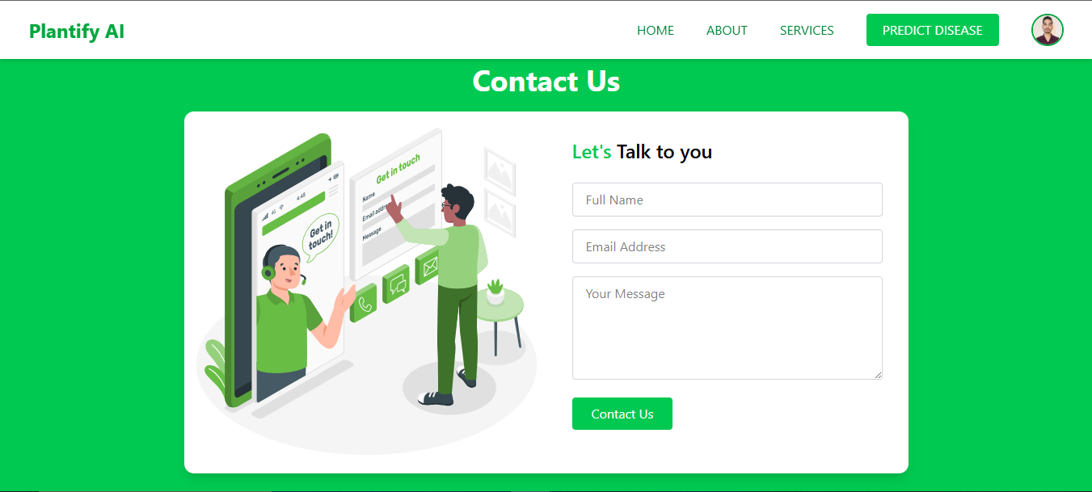
FRONTEND SCREENSHORTS

Slide 12
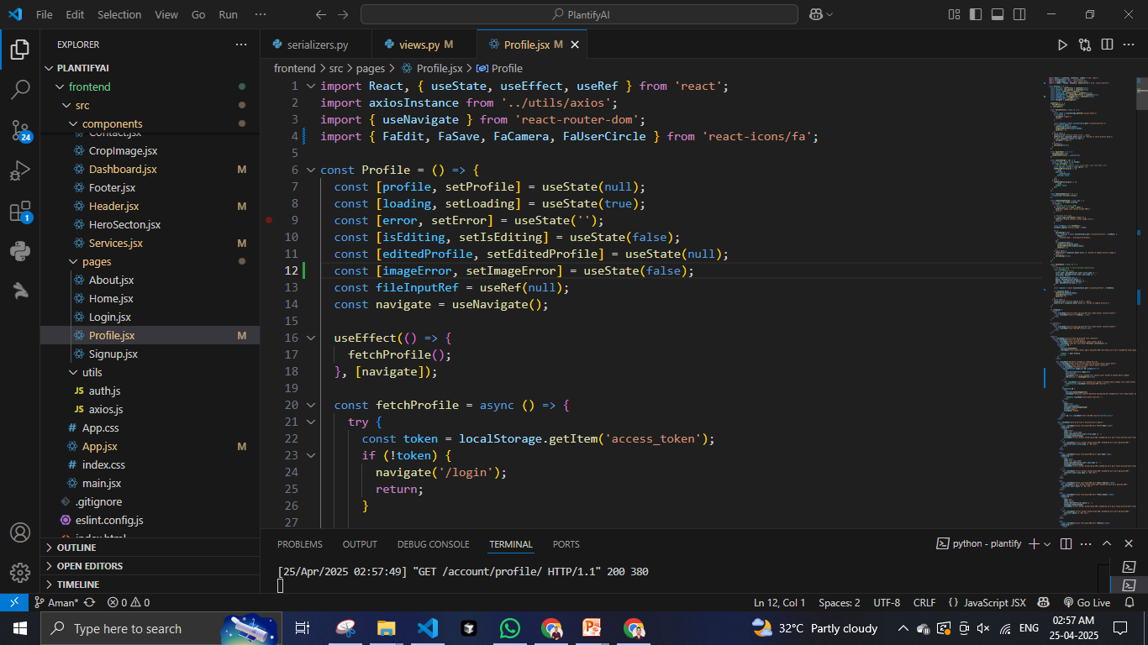
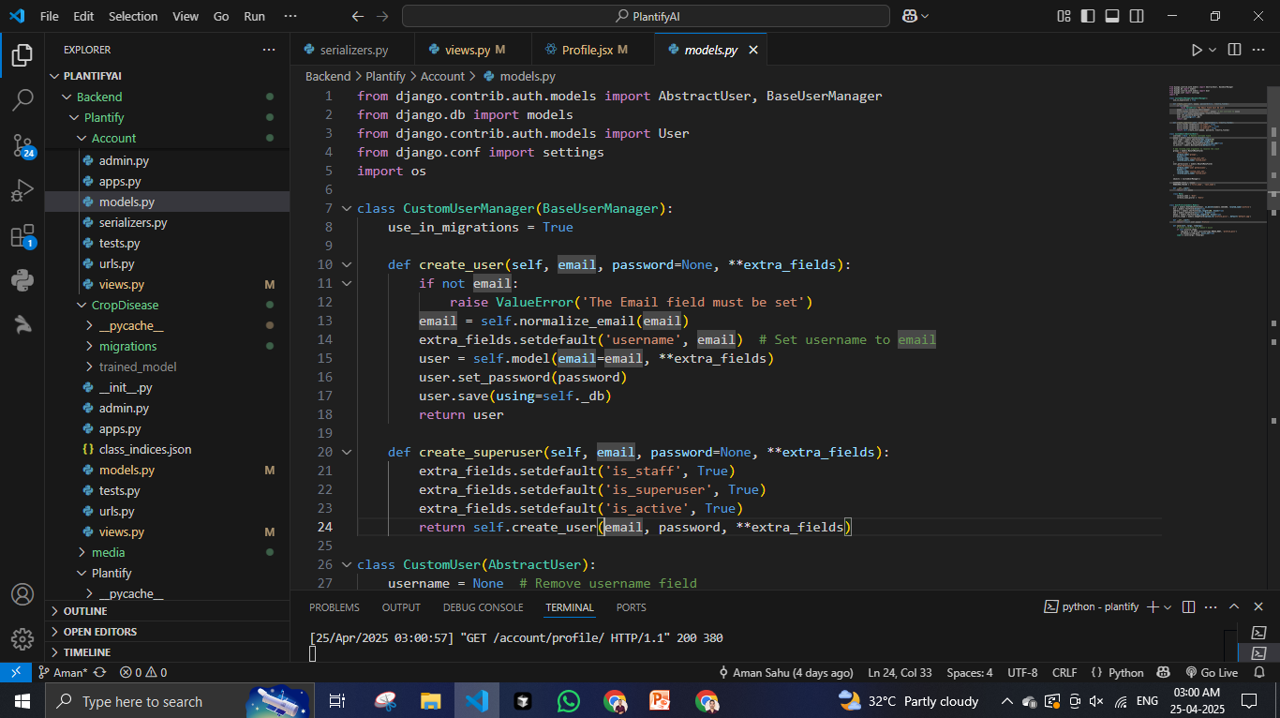
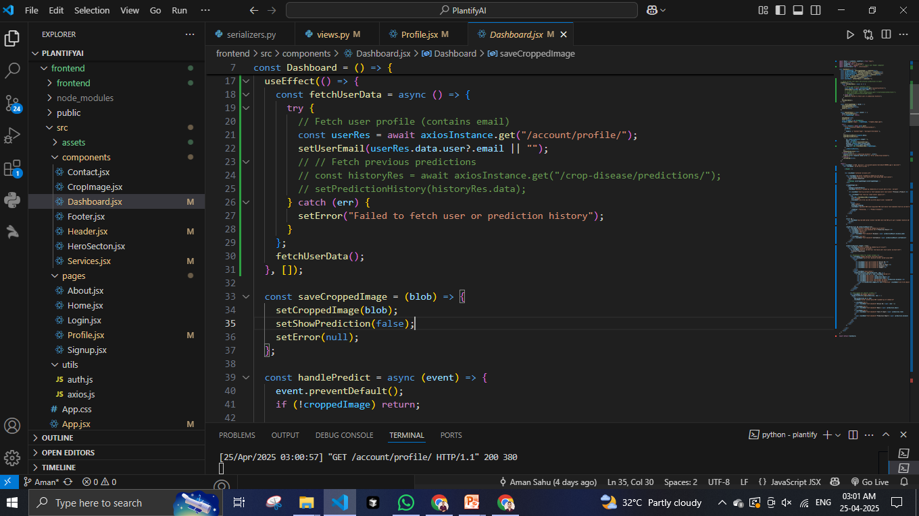
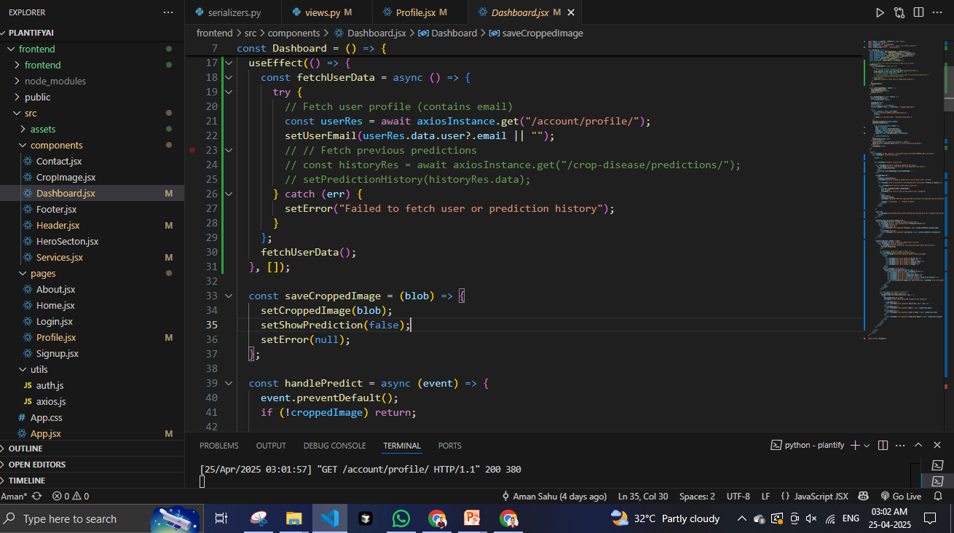
BACKEND SCREENSHORTS

Slide 13
THANK YOU

